Slide 1
Practical Sandboxing on the Windows Platform
An assessment of the Internet Explorer, Adobe Reader and Google Chrome sandboxes
By Tom Keetch

Slide 2
About Me
Senior Consultant for Verizon Business' Threat & Vulnerability Practice
Technical Lead for Code Review in EMEA
  Application Security Design Reviews
  Manual Code Review
  Static Analysis
My favourite topic is exploit mitigation!
  Make finding and exploiting vulnerabilities prohibitively expensive.

Slide 3
Introduction
Practical Sandboxing
  User-mode sandboxing methodology
  Based on Windows OS facilities
Implementers
  Protected Mode Internet Explorer (limited)
  Adobe Reader X
  Chromium
This presentation is about:
  Breaking out of such Sandboxes with the minimum required effort.

Slide 4
Agenda
Sandboxes for exploit mitigation (Theory)
Overview of Practical Sandboxing Implementations (Background)
Sandboxing Flaws (Practical)
A counter-argument to Adobe’s view of the sandbox
Conclusions

Slide 5
Sandboxes for Exploit Mitigation

Slide 6
Sandboxes for exploit mitigation
Two options:
  Increase cost of exploitation
  Decrease target value
But a second stage exploit, can usually bypass the sandbox for finite cost...
This presentation focuses on sandbox-escape.
Read the whitepaper for more further information.

Slide 7
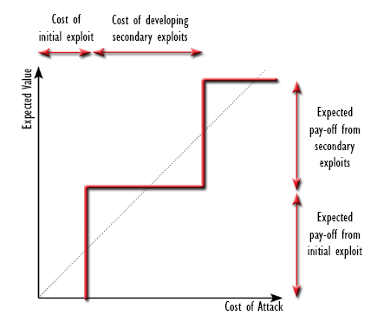
“Return-on-Exploitation”

Slide 8
Two Potential Failures
The cost of bypassing the exploit mitigation is too low to deter a potential attacker.
  (a) The target is still more valuable than the additional exploitation effort required.
  (b) The mitigation can be trivially bypassed.
The reduction of value of the target is not sufficient to deter a potential attacker.
  (a) The attacker is not interested in the resources protected by the mitigation.
  (b) Valuable assets are not protected by the mitigation.

Slide 9
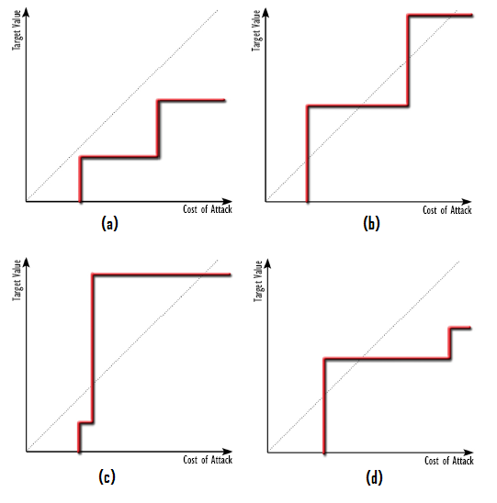

Slide 10
Looking for “cheap” exploits
This research set out to find the easiest places to find sandbox-escape exploits.
Cheap-to-find exploit types were found:
  Previously unexposed interfaces
  Easily detectable (and exploitable) conditions
Also, resources not protected by sandbox:
  Network Access
  Resources protected by the Same Origin Policy.

Slide 11
Overview of Practical Sandbox Implementations

Slide 12
The Practical Sandboxing
Methodology
Restricted Access token
  Deny-only SIDs (Discretionary)
  Low Integrity (Mandatory)
  Privilege Stripping (Capability)
Job Object Restrictions
Window Station Isolation
Desktop Isolation

Slide 13
Protected Mode Internet Explorer
Internet Explorer
(Broker)
Session
Workstation
Desktop
Medium Integrity
Low Integrity
Browser Tab
(Internet Zone)
Browser Tab
(Trusted Zone,
Local Intranet Zone)

Slide 14
Protected Mode Internet Explorer
Practical Sandboxing Check-list
OS Control | Implemented?
Restricted Token
- Restricted Token | No
- Privilege Stripping | Yes
- Low Integrity | Yes
Job Object Restrictions | No
Window Station Isolation | No
Desktop Isolation | No

Slide 15
Protected Mode Internet Explorer
Sandboxing
Only supported on Vista and later, because only Integrity Levels are used.
Only protected the Integrity of the system, not confidentiality.
See my previous presentation from Hack.LU 2010
  Not a Security Boundary, for many reasons.
  Lots of potential elevation routes.

Slide 16
Adobe Reader X
Adobe Reader
(Broker)
Session
Medium Integrity
(Workstation)
(Desktop)
PDF Renderer
Restricted Token
Low Integrity
Job Object

Slide 17
Adobe Reader X
Practical Sandboxing Check-list
OS Control | Implemented?
Restricted Token
- Restricted Token | Y
- Privilege Stripping | Y
- Low Integrity | Y
Job Object Restrictions | Partial
Window Station Isolation | N
Desktop Isolation | N

Slide 18
Adobe Reader X Sandboxing
Makes use of Chromium sandboxing and IPC framework (BSD license)
The broker does not restrict read access.
Sandbox doesn't protect clipboard or Global Atom Table.
No WinSta or Desktop isolation, but compensated for with Job Object restrictions.

Slide 19
Chromium
Google Chrome
(Broker)
Session
Medium Integrity
GPU
Process
Browser Tab
Plug-in
Restricted Token
Low Integrity
Job Object
Per plug-in
sandboxing.

Slide 20
Chromium
Practical Sandboxing Check-list
OS Control | Implemented?
Restricted Token
- Restricted Token | Yes*
- Privilege Stripping | Yes*
- Low Integrity | Yes*
Job Object Restrictions | Yes*
Window Station Isolation | Yes*
Desktop Isolation | Yes*
*Currently renderer only.

Slide 21
Chromium sandboxing
A flexible framework for applying the full “practical sandboxing” methodology
Renderer is in the most restrictive possible sandbox.
3rd Party Plug-ins are not sandboxed
  Adobe Flash, Shockwave etc.
GPU process is not sandboxed (planned for future release)

Slide 22
Cheap Exploit #1

Slide 23
BNO Namespace Squatting
Shared sections can be created with a name in the 'Local' namespace
  Shared Sections
  Mutexes, Events, Semaphores (Synchronisation objects)
By “squatting” on named object, we can set arbitrary permissions on the object if:
  It can be created before the application
  If the application does not fail if the named object already exists.
  If we know or can predict the name of the object.
This can expose applications outside the sandbox to attacks they never knew existed…

Slide 24
BNO Namespace Squatting
Example
TODO

Slide 25
Generic Sandbox escape vulnerability!
TODO

Slide 26
The Fuzzer that found it...
int _tmain(int argc, _TCHAR* argv[])
{
unsigned int size = _tstoi(argv[2]);
HANDLE hSection = CreateFileMapping(NULL, NULL, PAGE_EXECUTE_READWRITE, 0, size, argv[1]);
unsigned char* lpBuff = (unsigned char*) MapViewOfFile(hSection, FILE_MAP_WRITE | FILE_MAP_READ, 0, 0, size);
// Take a copy of the initial contents of the section.
memcpy(init, lpBuff, size);
while(1)
{
memcpy(lpBuff, init, sizeof(init));
for(unsigned int i = 32; i < size; i++)
if(rand() % 1000 < 5 ) lpBuff[i] = (unsigned char) rand();
PROCESS_INFORMATION ProcInfo1 = {0};
STARTUPINFOA StartupInfo1 = {0};
CreateProcessA(NULL, "C:\\Program Files\\Internet Explorer\\iexplore.exe", NULL, NULL, FALSE, 0, NULL, NULL,&StartupInfo1, &ProcInfo1);
CloseHandle(ProcInfo1.hProcess);
CloseHandle(ProcInfo1.hThread);
Sleep(2000);
PROCESS_INFORMATION ProcInfo2 = {0};
STARTUPINFOA StartupInfo2 = {0};
CreateProcessA(NULL, "pskill iexplore.exe", NULL, NULL, FALSE, 0, NULL, NULL, &StartupInfo2, &ProcInfo2);
CloseHandle(ProcInfo2.hProcess);
CloseHandle(ProcInfo2.hThread);
Sleep(1000);
}
return 0;
}

Slide 27
Cheap Exploit #2

Slide 28
NPAPI Interface Exploits
(Chromium Specific)
NPAPI was originally used to interface between the Netscape browser and an in-process plug-in.
Browser
Process
Browser Tab
NPAPI Plug-in
(DLL)
NPAPI

Slide 29
Out-of-Process NPAPI
Later NPAPI crossed process boundaries
Improved stability, no improved security.
Google Chrome
(Broker Process)
Session
Browser Tab
(Process)
Trusted
Plug-in
(Process)
NPAPI

Slide 30
NPAPI In Chrome (Today)
NPAPI now crosses a security boundary between sandboxed tabs and un-sandboxed plug-ins.
Google Chrome
(Broker Process)
Session
Browser Tab
(Process)
Trusted
Plug-in
(Process)
NPAPI
Sandbox

Slide 31
NPAPI Exploits
NPAPI Callers were previously trusted...
...Now they are not.
Flash and other plug-ins are currently not sandboxed.
Exploitable bugs in Adobe (and other vendors) code will allow sandbox-escape.
These bugs were previously not vulnerabilities
→ Calling conventions?

Slide 32
A benign crash?
Thread 9 *CRASHED* ( EXCEPTION_ACCESS_VIOLATION @ 0x09ccf232 )
0x102e5c06 [NPSWF32.dll - memcpy.asm:257] memcpy
0x102e1828 [NPSWF32.dll + 0x002e1828] CBitStream::Fill(unsigned char const*, int)
0x102e0b96 [NPSWF32.dll + 0x002e0b96] mp3decFill
0x102e0892 [NPSWF32.dll + 0x002e0892] PlatformMp3Decoder::Refill(int,unsigned char*)
0x10063d21 [NPSWF32.dll + 0x00063d21] CMp3Decomp::GetDecompressedData(short*,int,int,int,int)
0x10063f62 [NPSWF32.dll + 0x00063f62] CMp3Decomp::Decompress(short *,int)
0x100ad448 [NPSWF32.dll + 0x000ad448] CoreSoundMix::BuildBuffer(int)
0x100ae2c5 [NPSWF32.dll + 0x000ae2c5] CoreSoundMix::SendBuffer(int,int)
0x10153d6b [NPSWF32.dll + 0x00153d6b] PlatformSoundMix::SoundThread()
0x10154034 [NPSWF32.dll + 0x00154034] PlatformSoundMix::SoundThreadFunc(void *)
0x7c80b728 [kernel32.dll + 0x0000b728] BaseThreadStart
Full report @ http://crash/reportdetail?reportid=b370c132fc6587f7
Google Chrome 4.0.249.70 (Official Build 36218)
This was found by accident (using Chromium)
  Fixed by Adobe!

Slide 33
Input events
Can also send key and mouse events.
  NPP_InputEvent().
Possible to bypass Flash Security Dialogs
  Enable web-cam
  Enable Microphone
Plug-ins are currently unable to distinguish between user input and simulated input from renderer.

Slide 34
Cheap Exploit #3

Slide 35
Handle Leaks
Handles which refer to privileged resources may exist in sandboxes for several reasons.
A handle can be used for any operation for which it has already been granted access.
If the right type of handle is leaked into the sandbox, it can be used for sandbox-escape.
These handles are easily detected at run-time!

Slide 36
What causes “Handle Leaks”?
Deliberately granted by broker.
Accidentally granted by broker.
Incorrectly granted by broker (policy error)
Unclosed handles from sandbox initialisation
  Before Lock-down (init. with unrestricted token)
  Internal handles kept open by libraries
  Internal handles kept open by 3rd Party Hook DLLs

Slide 37
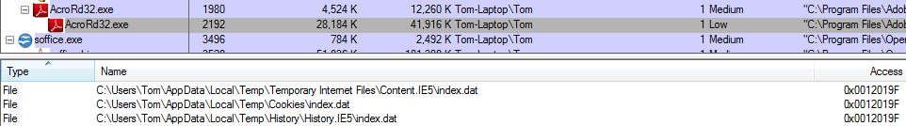
Adobe Reader X Handle Leaks
Sandboxed renderer has write access to the Medium-integrity Internet Explorer cookie store, history etc.
The ARX broker also doesn't currently restrict read access to local file system.

Slide 38
Cheap Exploit #4

Slide 39
Clipboard Attacks
In PMIE and AR-X, the clipboard is shared between the sandbox and the rest of the user's session.
Ever put your password in the clipboard?
What about attacking other applications?
Previously, the clipboard contents were normally trustworthy, now they are not.

Slide 40
Clipboard Attacks
What about...
  Pasting malicious command lines into a shell followed by a new line?
  Inputting maliciously formatted data into the clipboard?
Do application developers implicitly trust clipboard contents?

Slide 41
A counter-argument to Adobe’s
view of the sandbox

Slide 42
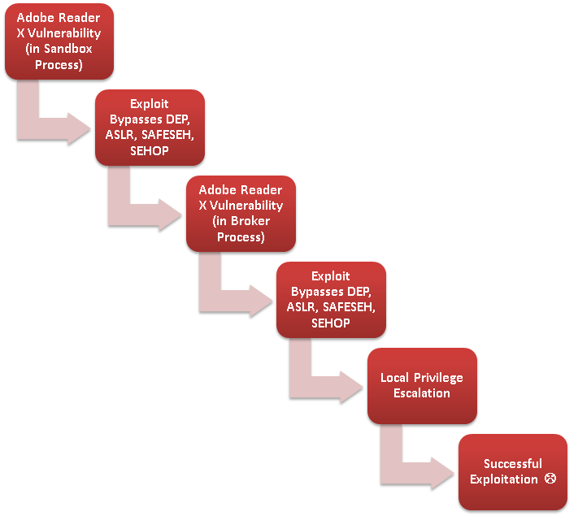

Slide 43
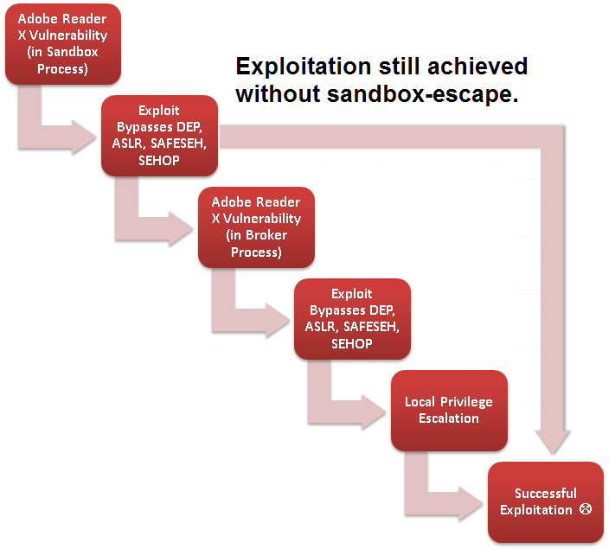

Slide 44
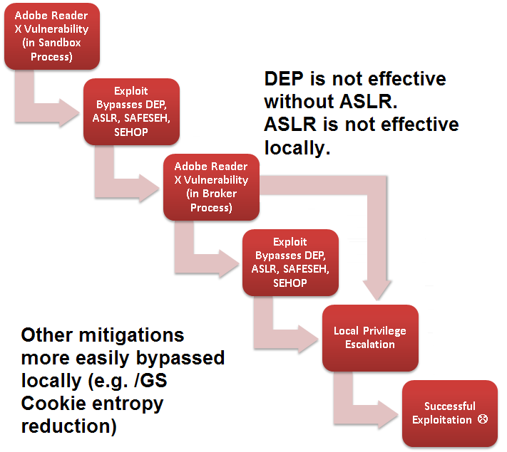

Slide 45
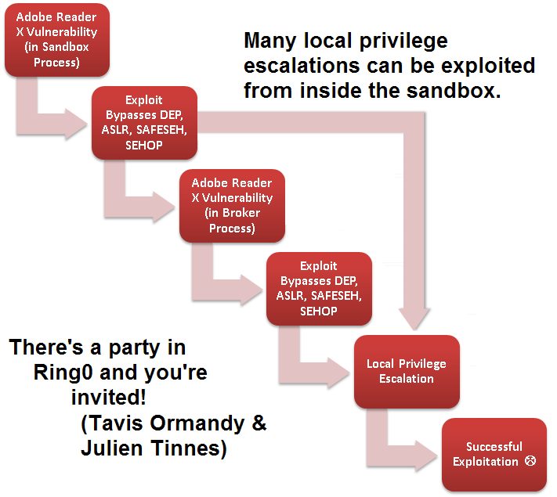

Slide 46
Conclusions

Slide 47
Conclusions
Developing sandbox escape exploits is currently significantly less effort than the initial remote exploit.
Not necessarily a big disincentive for attackers.
Especially if the goal is to steal a resource available inside the sandbox!

Slide 48
Conclusions
Sandboxes have changed the exploitation landscape and will continue to do so
  Greater emphasis on local privilege escalation
  Desktop applications under greater scrutiny
  New attack surfaces
When forced to attackers will start to adopt sandbox-aware malware.
  Insufficient motivation to do so yet!
  PMIE sandbox escapes only started getting attention when Pwn2Own made it a requirement of “own”.
  There are now at least 4 unpatched PMIE escapes (source: Twitter).

